Slide 1

Wireless Networking
Ambuj Varshney
ambujv@nus.edu.sg
Notes:
++ Thank you for inviting me to give this talk
++ In this talk, I will present a pathway that can enable us to make wireless embedded systems ubiquitous. I will describe my previous research efforts that tackle the critical challenges that limit the growth of wireless embedded systems. These are related to the growing energy asymmetry that exists between sensing, computation and communication blocks on these platforms.
++ Finally, I will conclude my talk by covering the research agenda that I would like to work on as a faculty member.

Slide 2
Discussion regarding Assignment 3
Assignment 3: April 8th 2024
Submission after deadline: Penalty of 10% Per Day
Deals with wireless communication
Additional sensor tags are available if required
Please submit statement of work and report. The statement of work should describe the contribution made by every member of the group. Only one member should submit the assignment on the canvas.
Notes:
++ We may all have heard of the term Internet of Things. So how are these wireless embedded systems related to the Internet of Things: Today, IoT includes a broad class of devices, including powerful platforms such as smartphones. However, it also includes more resource-constrained devices and what we call Wireless Embedded Systems, and in fact, I consider it to be one of the essential parts of the IoT ecosystem.
++ These are platforms equipped with a radio transceiver, sensor, microcontroller, and some form of energy storage. These platforms also often form a network, and sensor network as it is called has been an active area of research for the past two decades.
++ The research community has also developed wireless embedded platforms which we may know about, and these include: CMUCAM, which is an image sensor platform developed at Carnegie Mellon University, or Permamote is long life sensor platform from the lab I am associated with at UC Berkeley or Lorea which is a long-range backscatter platform that I had developed as part of my doctoral dissertation at Uppsala University. All of these are an example of Wireless Embedded Systems.

Slide 3
Next Week
NO Tutorial, NO Lecture
Doubts and QA: Please email TA’s – Kanav and Ayanga
Office hours: Still there. Please send me email for QA.
Video lectures: Will upload lecture to cover some topics due to missed lectures due to public holiday
Notes:
++ We may all have heard of the term Internet of Things. So how are these wireless embedded systems related to the Internet of Things: Today, IoT includes a broad class of devices, including powerful platforms such as smartphones. However, it also includes more resource-constrained devices and what we call Wireless Embedded Systems, and in fact, I consider it to be one of the essential parts of the IoT ecosystem.
++ These are platforms equipped with a radio transceiver, sensor, microcontroller, and some form of energy storage. These platforms also often form a network, and sensor network as it is called has been an active area of research for the past two decades.
++ The research community has also developed wireless embedded platforms which we may know about, and these include: CMUCAM, which is an image sensor platform developed at Carnegie Mellon University, or Permamote is long life sensor platform from the lab I am associated with at UC Berkeley or Lorea which is a long-range backscatter platform that I had developed as part of my doctoral dissertation at Uppsala University. All of these are an example of Wireless Embedded Systems.

Slide 4
Roadmap of the lecture today
General course information and updates
Let us review what we had covered the last lecture
MAC: Controlled Access
Medium access control for internet of things
Localisation
Notes:
Here is the roadmap of the major topics that I am going to cover during the presentation. We have already covered the exponential growth of the internet of things; next, I will talk about the critical energy challenge that can severely hinder this massive growth and preventing us from realising this immense economic value enabled by the IoT.

Slide 5
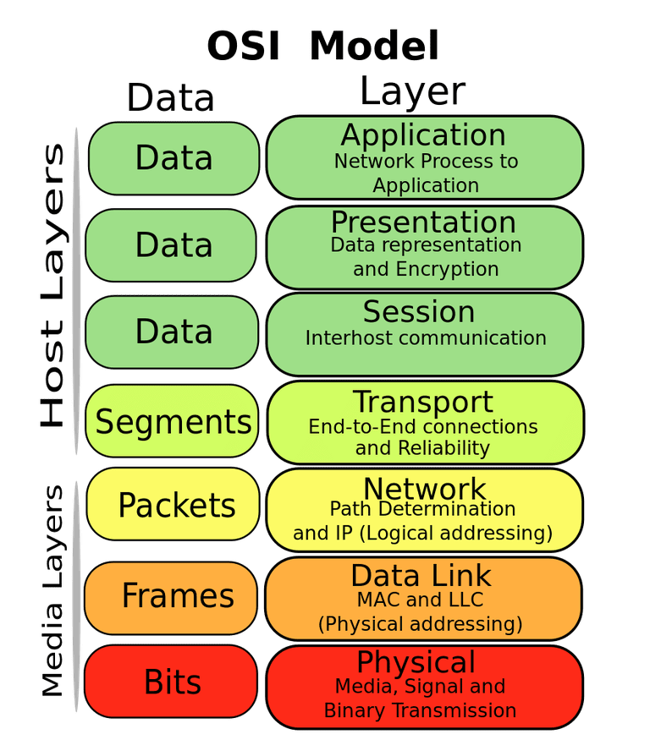
OSI model of communication layers
Transport
How to form connections between computers
TCP and UDP
Network
How to send packets between networks
IP
Data Link
How to send frames of data
Ethernet, WiFi
Physical
How to send individual bits
Ethernet, WiFi

Slide 6
Data Link Layer
Framing
Combine arbitrary bits into a “packet” of data
Logical link control
Manage transfer between transmitter and receiver
Error detection and correction
Media access
Controlling which device gets to transmit next
Inherently coupled to PHY and its decisions

Slide 7
Error control: detection and recovery
Detection: only detect errors
Make sure corrupted packets get discarded
Cyclical Redundancy Checks
Detect single bit errors
Detect “burst” errors of several contiguous bits
Recovery: also try to recover from small bit errors
Forward error correction
Retransmissions
Far more important for wireless because the cost of transmission is higher

Slide 8
Wireless is a shared medium
Wired communication has signals confined to a conductor
Copper or fiber
Guides energy to destination
Protects signal from interference
Wireless communication is inherently broadcast in nature
Energy is distributed in space
Signals must compete with other signals in same frequency band

Slide 9
Wireless: What are challenges of multiple access
Problem: Multiple radio transmitters want to access a common channel
How to coordinate access for these radio transmitters ?

Slide 10
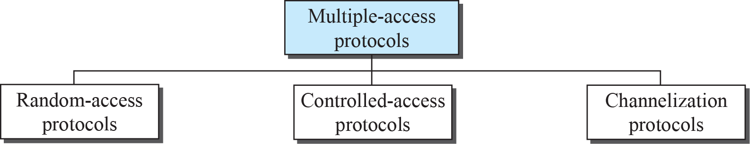
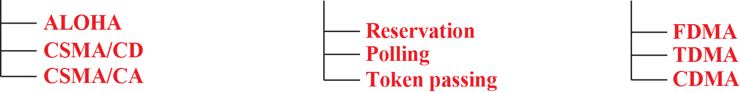
Taxonomy of multiple-access protocols
Reduce collision,
“manage” retransmission
Avoid collision

Slide 11
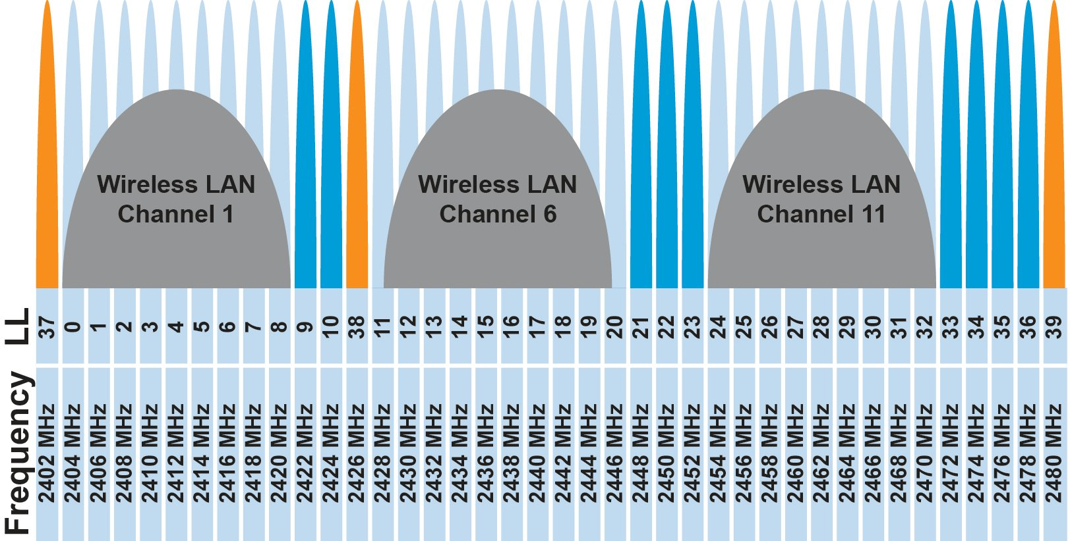
FDMA – Frequency Division Multiple Access
Separate transmissions by placing them at different frequencies
Technically, each device can use a separate, fixed frequency
One example can be walkie-talkies
What are disadvantages of giving every device own frequency?
Conceptually, how RF channels work
WiFi networks pick different bands
802.15.4 picks a channel to communicate on

Slide 12
Orthogonal Frequency Division Multiplexing :OFDM
In FDM, the entire frequency spectrum is dedicated to carry data from a single source
Example: transmit at 40Mbps over a 20 MHz spectrum
In OFDM, data is divided into many (slower) bit streams and multiple subcarriers (each with smaller spectrum) is used
Example: divide data source into 40 sources, each 1Mbps

Slide 13
TDMA – Time Division Multiple Access
Split transmissions in time
Devices share the same channel
Splits time into fixed-length windows
Each device is assigned one or more windows
Can build a priority system here with uneven split among devices
Requires synchronization between devices
Often devices must listen periodically to resynchronize
Less efficient use of slots reduce synchronization
Large guard windows. E.g. 1.5 second slot for a 1 second transmission

Slide 14
TDMA vs. FDMA
FDMA
TDMA
Frequency
Frequency
Time
Time
In practical systems, TDMA is often combined with FDMA
Frequency
Time
Notes:
14
14

Slide 15
Pros/Cons of “Static” Allocation
Pros:
Resource is always available, performance guarantee
No interference from other users
Cons:
Inefficient if resource is not utilized. Resource cannot be used by other users
Slow to adjust to traffic demand changes

Slide 16
Orthogonal Frequency Division Multiplexing :OFDM
In FDM, the entire frequency spectrum is dedicated to carry data from a single source
Example: transmit at 40Mbps over a 20 MHz spectrum
In OFDM, data is divided into many (slower) bit streams and multiple subcarriers (each with smaller spectrum) is used
Example: divide data source into 40 sources, each 1Mbps

Slide 17
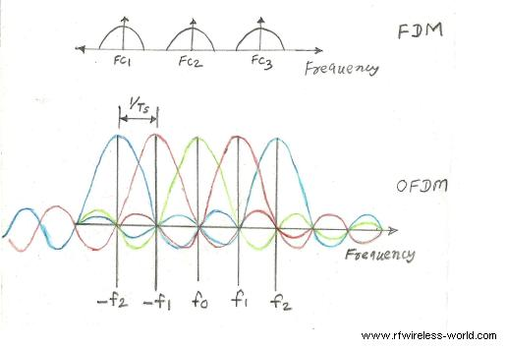
OFDM vs FDM
http://www.rfwireless-world.com/Articles/difference-between-FDM-and-OFDM.html

Slide 18
What are benefits of OFDM
Robust to selective fading
Overcomes inter-symbol interference in a multi-path environment because data rate per subcarrier is lower
Applications:
IEEE 802.11a, g, n and ac
LTE/5G
Digital radio and TV broadcast

Slide 19
Frequency and Time leads to Spread Spectrum (SS)
Spread-spectrum techniques are methods by which a signal is deliberately spread in the frequency domain, resulting in a signal with a wider bandwidth
Such techniques can be used to establish secure communications, increase resistance to natural interference, jamming and to prevent detection
Concept has been alluded to in 1900s, and applied in some form during WWII
Resistant to narrowband interference
Signals are difficult to interpret – appears as if increase in background noise
Can share frequency band with others with minimal interference

Slide 20
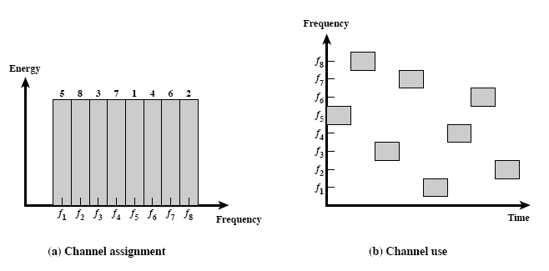
Spread spectrum: Frequency Hopping (FH)
FHSS increase resistance to a) natural interference b) jamming c) detection

Slide 21
Spread spectrum: Frequency Hopping (FH)
A protocol that we use everyday uses Frequency hopping spread spectrum technique?
Bluetooth hops between 79 different 1 MHz channels in the band.

Slide 22
Random access protocol: ALOHA
ALOHAnet (1971)
University of Hawaii – Norman Abramson
First demonstration of wireless packet network
Rules
If you have data to send, send it
Two (or more) simultaneous transmissions will collide and be lost
Wait a duration of time for an acknowledgement
If transmission was lost, try sending again “later”
Want some kind of exponential backoff scheme here

Slide 23
Packet collisions
Each packet transmission has a window of vulnerability
Twice the on-air duration of a packet
Transmissions during the packet are bad
Transmissions before packet can also be bad

Slide 24
Slotted ALOHA
Split time into synchronized “slots”
Any device can transmit whenever it has data
But it must transmit at the start of a slot
And its transmission cannot be longer than a slot
Removes half of the possibilities for collisions!
At the cost of some synchronization method
time

Slide 25
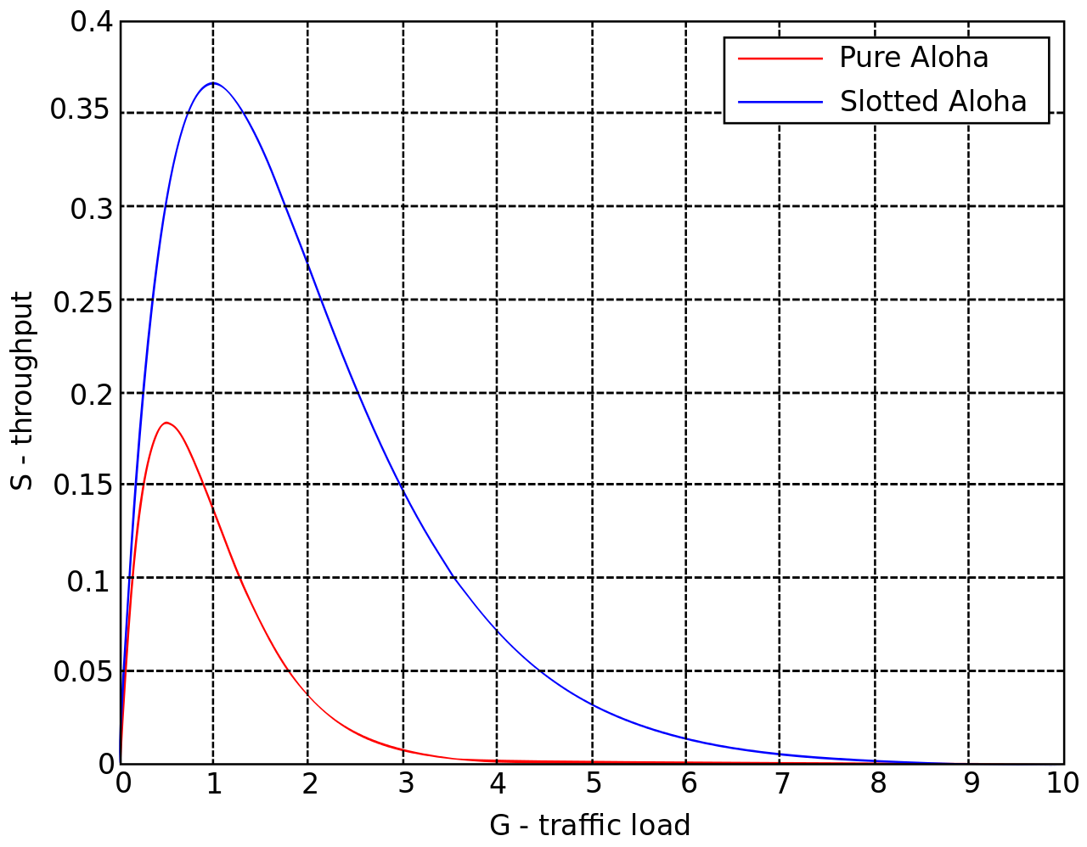
What is the maximum throughput of ALOHA
It can be shown that traffic maxes out at
ALOHA: 18.4%
Slotted ALOHA: 36.8%
Assuming Poisson distribution of transmission attempts
Slotted throughput is double because the “before” collisions can no longer occur

Slide 26
Carrier Sense Multiple Access
Carrier Sense Multiple Access:
sense carrier
If idle,
send
wait for ack
If there isn’t one, assume there was a collision, retransmit
Should we transmit immediately once channel is idle?

Slide 27
Carrier Sense Multiple Access/ Collision Avoidance
CA – Collision Avoidance
if the channel is clear, deferred transmission for a "random" interval
Choose interval from a uniform distribution with values between 0 and maximum window size W_{max}
reduces the probability of collisions on the channel
How large should W_{max} be?
If interval is long, time is “wasted” …
If interval is too short?

Slide 28
CSMA/CA: Choosing W_{max}
Should W_{max} be constant?
Intuitively, W_{max} should be small when there is lower chance of collision and vice versa
W_{max} varies according to the Binary Exponential Backoff (BEB) algorithm.
Set “slot time” to 2 times the max. propagation delay on the channel
If this is the first transmission, sends immediately
If there is a collision, after i-th collision, pick W_{max} randomly between 0 and 2^{i}-1 time slots.

Slide 29
CSMA/CA: Trade-off
What are the Trade-off:
More aggressive (smaller W_{max}) – more likely to achieve higher channel utilization, but also more likely to collide
Less aggressive – lower channel utilization, less likely to collide
Utilization vs. delay
Overly aggressive or conservative can increase delay
Optimal point depends on
Number of stations/nodes contenting
Traffic load

Slide 30
Hidden terminal problem
Device C
Device A
Device B

Slide 31
CSMA with RTS/CTS
Hidden terminal problem means that two transmitters might never be able to detect each other’s transmissions
A partial solution
When channel is idle, transmitter sends a short Request To Send (RTS)
Receiver will send a Clear To Send (CTS) to only one node at a time
RTS collisions are faster and less wasteful than hidden terminal collisions
Downside: overhead is high for waiting for CTS when contention is low

Slide 32
Solving Hidden Terminal Problem
B
RTS
CTS
CTS
A
C
OK, I’ll wait …

Slide 33
Collisions are always bad?

Slide 34
Receiving transmissions with collisions
Collision does not always lead to packet loss
If a receiver hears from two or more stations and the signal from one station is much stronger than the rest, the receiver can receive the signal correctly “only” from this station: This is called capture effect.

Slide 35
Flooding is a recreation of broadcasts
Goal: get information to all nodes
This is the problem of “data dissemination”
Problem: difficult in Mesh topologies
Packet loss, retransmission delays
Really, data dissemination is just to broadcast to all nodes
But broadcast transmissions don’t reach far enough to cover entire mesh

Slide 36
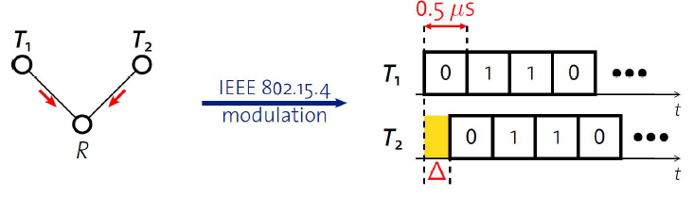
Synchronous transmissions
Multiple nodes transmit same packet at same time
R can receive packet with high probability if Δ is small
May even improve probability of reception (more energy at receiver)
500 ns is 1/32 of a symbol for 802.15.4 (chip duration)

Slide 37
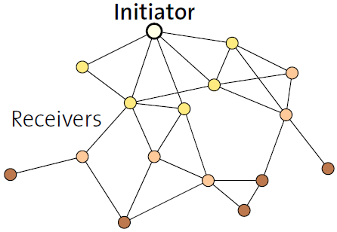
Fast packet propagation in Glossy

Slide 38
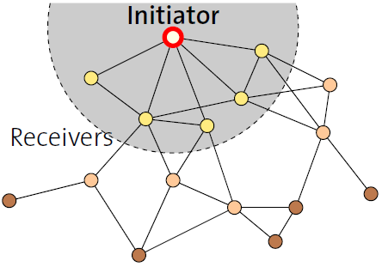
Fast packet propagation in Glossy

Slide 39
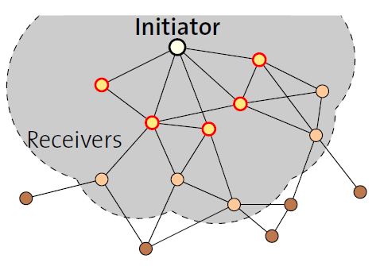
Fast packet propagation in Glossy

Slide 40
Roadmap of the lecture today
General course information and updates
Let us review what we had covered the last lecture
MAC: Controlled Access
Medium access control for internet of things
Localisation
Notes:
Here is the roadmap of the major topics that I am going to cover during the presentation. We have already covered the exponential growth of the internet of things; next, I will talk about the critical energy challenge that can severely hinder this massive growth and preventing us from realising this immense economic value enabled by the IoT.

Slide 41
Medium access control: Controlled Access
How do you control who has access to medium?
Reservation
Polling
Token Passing

Slide 42
Medium access control: Reservation access method
A station needs to make a reservation before sending data
Example:
time is divided into reservation and data slots
reservation frame precedes the data frames sent
System is more efficient if many data frames are sent after one reservation
Reservation Contention Slots
Data Slot
Reservation Contention Slots
Data Slots

Slide 43


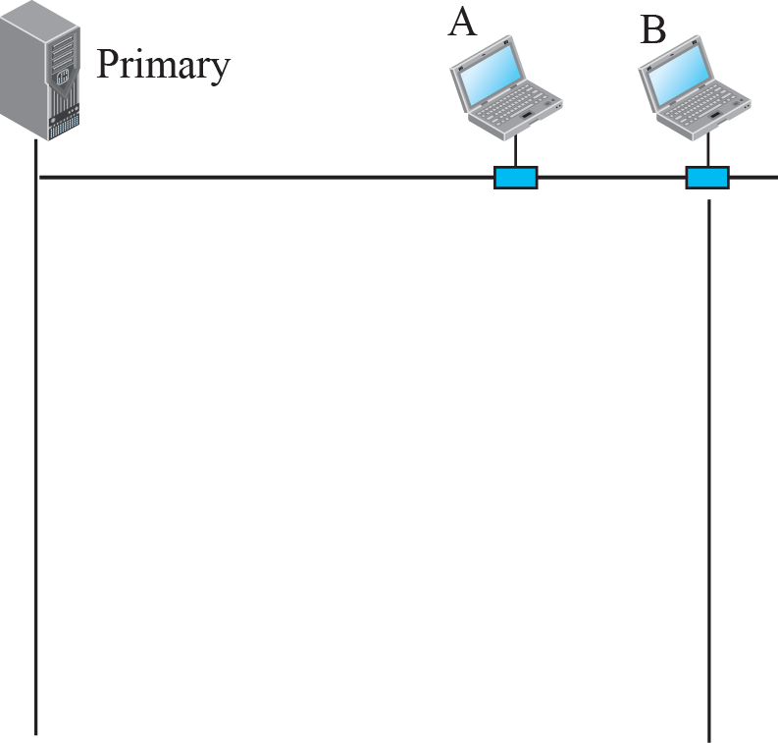
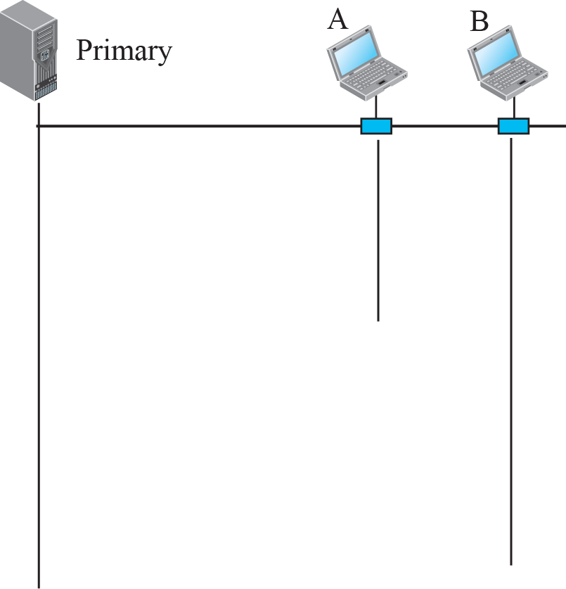
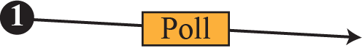
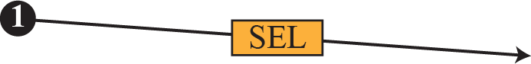
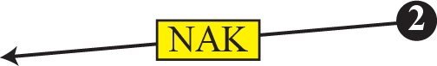
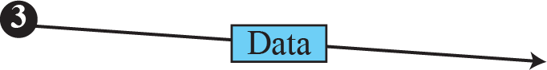
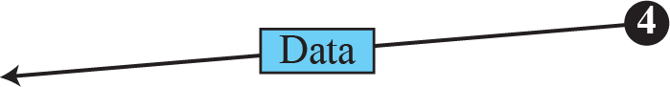
Medium access control: Polling
One primary and many secondary stations
Select: primary station sends to a secondary station
Poll: primary station ask if a secondary station has data to send

Slide 44
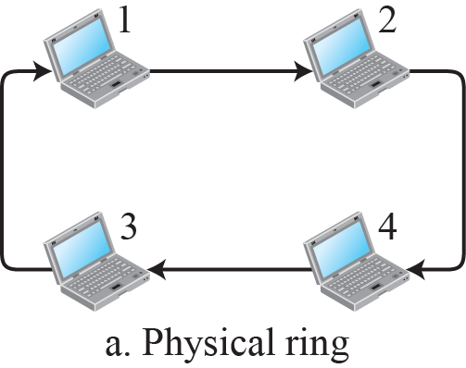
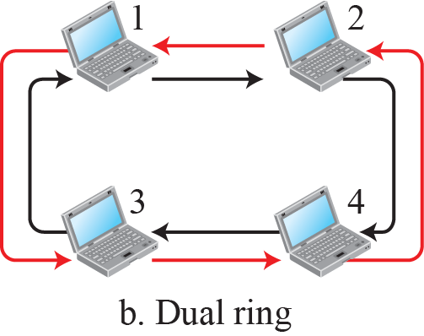
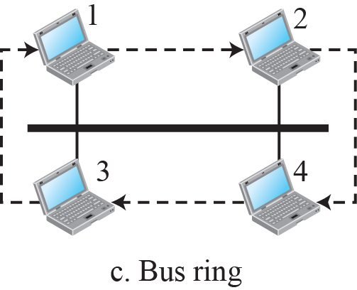
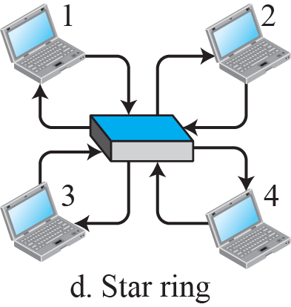
Medium access control: Token Passing

Slide 45
Question: Appropriate medium access protocol
Question: For each of the following applications, explain what is the most appropriate MAC protocol that should be used. Explain your choice.
Web browsing
VoIP
Low rate control traffic and carrier sensing is not performed

Slide 46
Question: Appropriate medium access protocol
Question: For each of the following applications, explain what is the most appropriate MAC protocol that should be used. Explain your choice.
Web browsing: CSMA/CA, high throughput, sharing among users with bursty traffic
VoIP
Low rate control traffic and carrier sensing is not performed

Slide 47
Question: Appropriate medium access protocol
Question: For each of the following applications, explain what is the most appropriate MAC protocol that should be used. Explain your choice.
Web browsing: CSMA/CA, high throughput, sharing among users with bursty traffic
VoIP: Polling/TDM/Reservation, requires low loss, short latency.
Low rate control traffic and carrier sensing is not performed

Slide 48
Question: Appropriate medium access protocol
Question: For each of the following applications, explain what is the most appropriate MAC protocol that should be used. Explain your choice.
Web browsing: CSMA/CA, high throughput, sharing among users with bursty traffic
VoIP: Polling/TDM/Reservation, requires low loss, short latency.
Low rate control traffic and carrier sensing is not performed
Aloha/slotted Aloha, low data rate does not perform carrier sensing

Slide 49
Roadmap of the lecture today
General course information and updates
Let us review what we had covered the last lecture
MAC: Controlled Access
Medium access control for internet of things
Localisation
Notes:
Here is the roadmap of the major topics that I am going to cover during the presentation. We have already covered the exponential growth of the internet of things; next, I will talk about the critical energy challenge that can severely hinder this massive growth and preventing us from realising this immense economic value enabled by the IoT.

Slide 50
Medium Access Control for Internet of Things

Slide 51
Medium access control for Internet of Things
Medium access control for normal wireless devices
Low Latency
High Utilization
Fair (every has chance to communicate)
How about medium access control for internet of things?
Power Consumption should be as small as possible
(Most) sensor applications have low channel utilization
Designing medium access control with energy consideration as priority?

Slide 52
Energy consumption of medium access control
The main sources of energy consumption in any contention-based MAC protocol:
overhearing
control packet overhead
data transmission/reception
idle listening
(1) – (3) occurs only when there is a transmission
(4) occurs even when there is no traffic

Slide 53
“Life Cycle” of MAC Protocols
(4)
(1) – (3)
(4)
(1) – (3)
(4)
(1) – (3)
Less Traffic
(4)
(1 – (3)
(4)
(1) – (3)
Less Traffic
(4)
(4)

Slide 54
Idle listening is energy expensive
Idle listening consumes most of the energy as traffic load decreases
Idle listening consumes 50–100% of the energy required for receiving
Overhearing or passive listening is expensive, particularly, for low utilization
What can be done? Don’t overhear, go to sleep!
Advantage:
Consume very little energy when radio is idle/inactive
Problem:
When to wakeup? Without waking up cannot receive or transmit?
Requirements:
Wakeup schedule must be coordinated
The “right” nodes must wake up at the “right” time

Slide 55
Let's consider energy-efficient Aloha protocol
ALOHA: No change to the protocol: a node wants to transmit, it does
Does it work?
There is no contention (usually true when utilization is low)
The receiver is listening (may not be true with duty cycle)
So how do we convert ALOHA to work with duty cycled radios?

Slide 56
Aloha with Preamble Sampling
Sensing
Sensing
Sensing
Sensing
Receiver
Sender
Preamble
Data
Sensing
Sensing
Sensing
Recv
ACK
Receiver 1
Sensing
Sensing
Receiver 2
(Possible we can miss the preamble and thus data?)

Slide 57
Aloha with Preamble Sampling
Tp
Sender
Preamble
Data
Sensing
Sensing
Sensing
Recv
ACK
Receiver 1
Ts
T_{D}
Each receiver periodically (every Tp) wakes up to check if the channel is busy for a duration of (Ts)
If channel is busy, stays in listening mode until destination of data is known (transmitted), else go back to sleep for a period of (Tp-Ts)
Sender transmits a long preamble (Tp), and then send data packet at the end of the preamble period of packet transmission
Is this protocol energy efficient? Why? And Why Not?

Slide 58
B-MAC: Asynchronous Medium Access Control
B-MAC asynchronous MAC protocol. Based on concept of preamble sampling
Nodes periodically activate their radios to detect signals; remain active upon receiving a packet or go to sleep after a set timeout if no activity is detected
To guarantee packet reception, the preamble duration must be at least as long as the channel sampling rate
The preamble time (Tp) should align with the channel check interval for reception; for instance, a 100ms check requires a minimum 100ms preamble

Slide 59
Improving B-MAC
While the design of B-MAC makes suitable for low power/low duty operations, its performance can be improved
Transmitter:
Is a long (continuous) preamble necessary?
(Potential) Receivers:
Is a long (average) waiting period necessary?

Slide 60
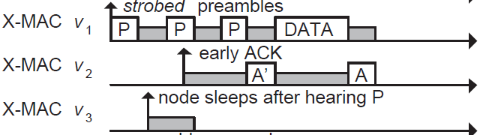
Improving B-MAC with X-MAC
X-MAC improves over B-MAC
Sender transmits many “probes” with gaps between probes. Each probe contains address of intended receiver
Receiver checks address embedded in probe, sends acks if it is the destination during the gap period between probes
Sender transmits DATA, receive replies with Ack to complete data transfer

Slide 61
ContikiMAC
ContikiMAC is the MAC protocol implemented in Contiki OS

Slide 62
Synchronous MAC: S-MAC Protocol
Why not let all nodes wakeup at the same time?
SMAC’s solution
Some form of time division multiplexing
Divide interval into listening and sleeping
Percentage of listening period is the “duty cycle”
Example: 10% duty cycle
Each node listens for 100ms and sleep for 0.9s
Each node listens for 1s and sleeps for 9s

Slide 63
One of the last year’s question
Question: In an IoT device deployment, the devices are equipped with backscatter transmitters and conventional radio receivers. The transmission power consumption is very negligible compared to the reception power consumption. Please refer to following table (below) for detailed breakdown of power consumed for various communication tasks:
Transmission | Reception | Channel Sensing | Idle listening | Sleep
100 microwatts | 5 milliwatts | 2 milliwatts | 1 milliwatts | 10 microwatts

Slide 64
One of the last year’s question
Question (Continued): You are implementing a medium access control protocol like B-MAC, in which receivers periodically wake up to check for transmissions. Transmitters initiate communication by sending a very long preamble, which is then followed by data packets. In this question, the receiving device wakes up every 100 milliseconds and then performs channel sensing for 2 milliseconds.

Slide 65
One of the last year’s question
(a). In the absence of transmissions (no data packet being sent), calculate the average energy spent in idle listening, sleeping, channel sensing, and transmission states. (2 point)
(b) What should be the length of preamble transmission? (1 point)
(c) If the bitrate (PHY) of the transmitter is 1 Megabit per second and a data packet size is of the size 1 kilobyte, calculate the transmission and reception durations for the data packet? Please also estimate total time the transmitter is active for sending of one data packet. (2 point)

Slide 66
One of the last year’s question
Question (d) Calculate energy spent in different radio states (idle listening, sleeping, channel sensing, and transmission) for the two types of traffic: Beacons (data packet sent every second) and Audio (5 data packets sent every second). 1 data packet is 1 kilobyte in size. (5 point)
Question (e) If you are given a coin cell with 240 mAH at 3 Volts. How long would the battery last when transmitting beacons and audio? (Using the values calculated in part (d)) (2 point)

Slide 67
One of the last year’s question
Answer (a) The receiving device wakes every 100 milliseconds (0.1 seconds) and performs channel sensing for 2 milliseconds (0.002 seconds). Without data packet transmissions, there is no additional energy that is spent on data transmission and data reception.
Channel Sensing: 0.000004 Joules (0.002 watts x 0.002 seconds)
Sleep: 0.00000098 Joules (0.00001 watts x 0.098 seconds)
Idle Listening: 0 Joules
Transmission: 0 Joules
Answer (b) 100+2 milliseconds
Answer (c) Transmission and Reception duration of only data packet: 8 milliseconds
The transmitter would also need to send preamble, 102 milliseconds + 8 milliseconds.

Slide 68
Roadmap of the lecture today
General course information and updates
Let us review what we had covered the last lecture
MAC: Controlled Access
Medium access control for internet of things
Localisation
Notes:
Here is the roadmap of the major topics that I am going to cover during the presentation. We have already covered the exponential growth of the internet of things; next, I will talk about the critical energy challenge that can severely hinder this massive growth and preventing us from realising this immense economic value enabled by the IoT.

Slide 69
What do you mean by the term localization?

Slide 70
What do you mean by the term localization?
Localization systems determine the physical coordinates of an electronic device such as IoT nodes, drones, mobile phones or a subject
These physical coordinates of electronic devices are:
Global - aligned with some externally meaningful systems like GPS
Relative - some “rigid transformation” (rotation, reflection, translation) away from a global coordinate systems
Localization indoors: goal is positioning things within a building
Where can I find X?
X: where am I located?
X and Y: are we near each other?

Slide 71
Location of object with respect to?
Absolute location
X, Y, Z position based on already known infrastructure locations
Like GPS does
Installed localization hardware known as anchors
Relative location
Position relative to some other device
Technically absolute location is a version of this
Might only need a few devices
How far is the smartphone from the computer?

Slide 72
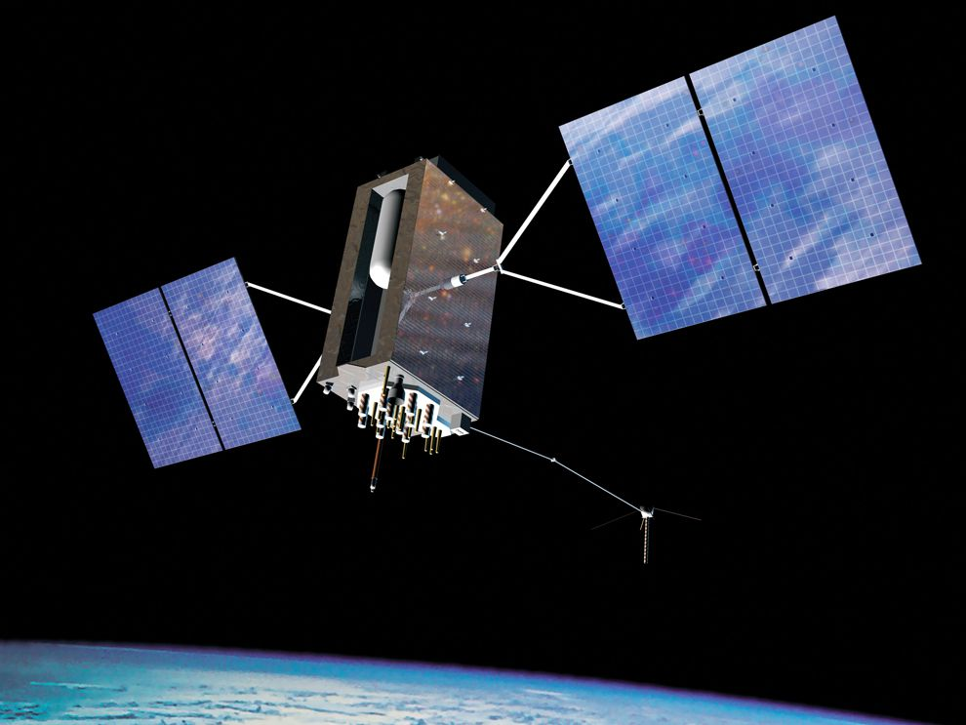
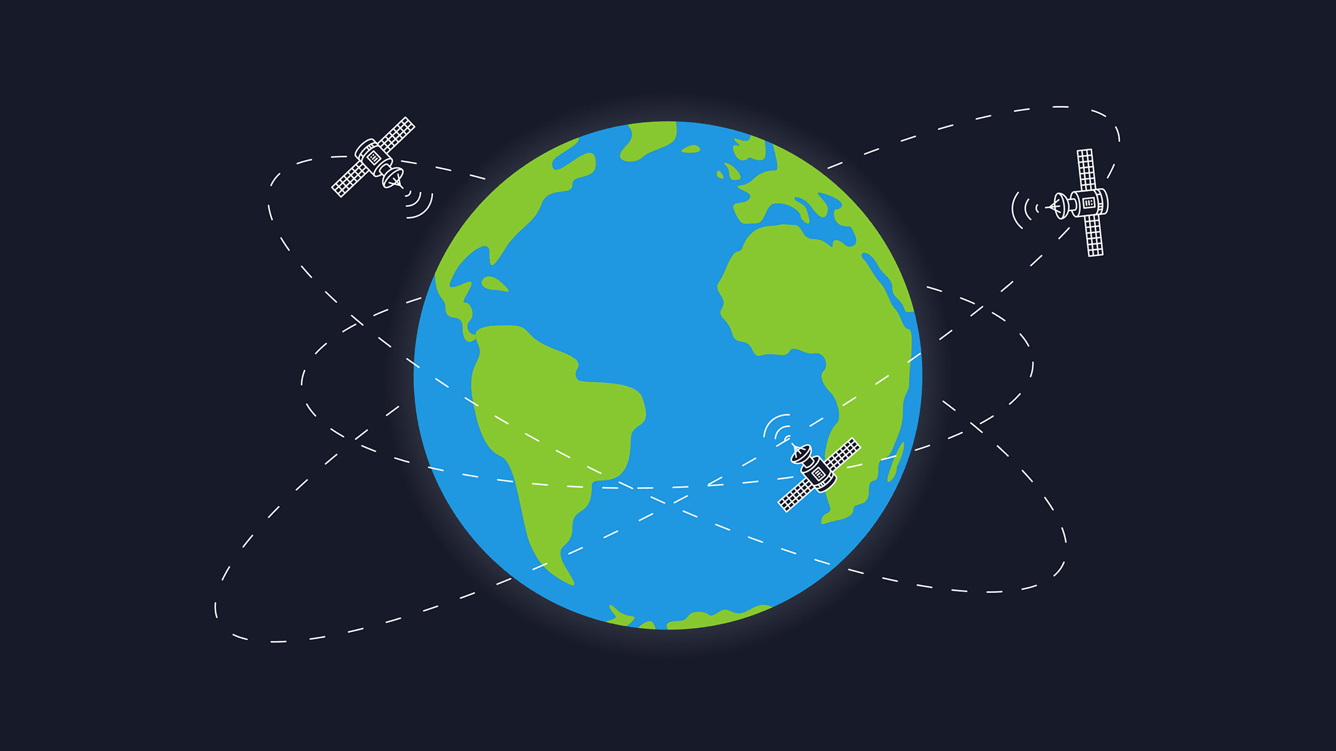
Well know example of the localization system

Slide 73
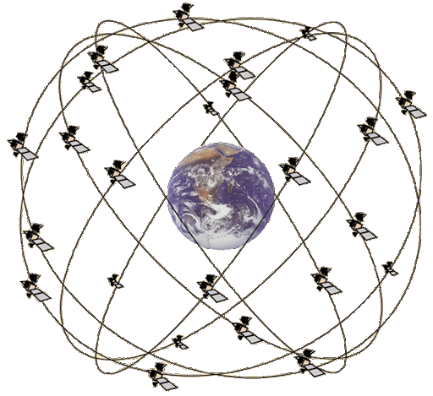
Overview of Global Positioning System
Satellites placed in Medium Earth Orbit (20,000 KM)
Orbit earth twice per day
Placed such that 4 are in view everywhere, always
31 total in orbit as of November 2020
Most recent launch November 5th 2020
Comparisons
LEO 200-2000 km, ISS at 340 km
GEO 35,000 km

Slide 74
Global Positioning Service
How does GPS work?
Know the position of all satellites
Receive signals from multiple satellites
Determine distance from each satellite
Trilateration

Slide 75
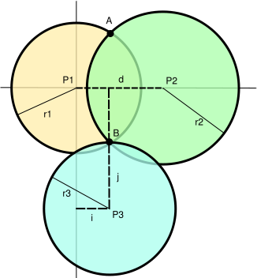
Range based localisation system
Beacon/Anchor/Landmark
Ranging
How many beacons do you need?

Slide 76
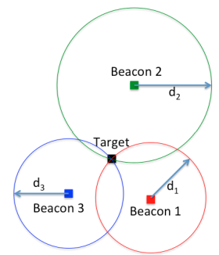
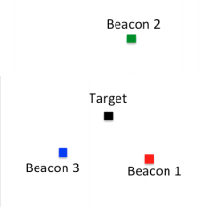
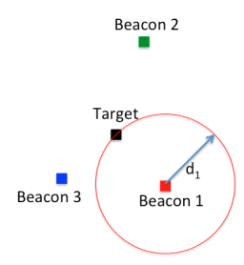
What is trilateration?
Determine distance from each beacon, then find position
Apply trigonometry to solve triangle with beacons.
Requires: 3 lengths (or some angles and lengths…)
Solve two triangles and get 3D position
Most common and accurate localization approach

Slide 77
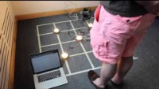
Trilateration using beacons sent using light
Ye-Sheng Kuo, Pat Pannuto, Ko-Jen Hsiao, and Prabal Dutta. 2014. Luxapose: indoor positioning with mobile phones and visible light. In Proceedings of the 20th annual international conference on Mobile computing and networking (MobiCom '14)

Slide 78
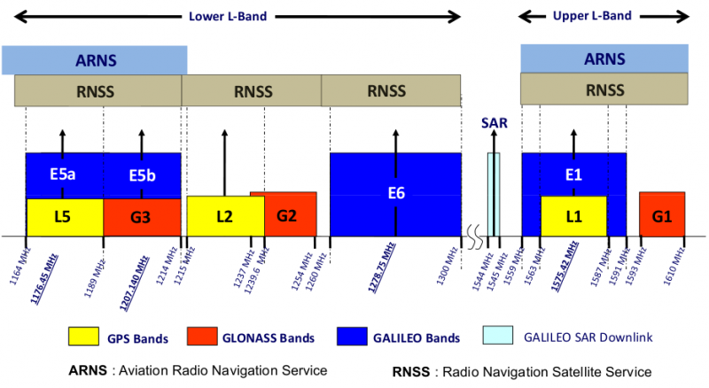
GPS PHY
GPS frequency
1.2 GHz and 1.5 GHz
10-15 MHz bandwidth
BPSK modulation
Signal has to travel 20,000 km, but most of that is through space
Tx power 25 Watts (44 dBm)
Rx sensitivity -140 dBm to -160 dBm (50 bps data rate)
~200 dBm total link budget

Slide 79
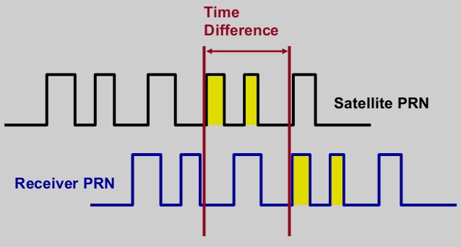
GPS transmissions
Each satellite sends a unique pseudo-random number sequence
Sequence repeats in time (over minutes) and is well-known
Position in signal is used to calculate time of flight

Slide 80
GPS requires signals from multiple satellites
4 satellites are needed to determine location and time
3 for 2D location (assume on ground) and 1 for time offset
Solve for both as a single equation
Steps to finding location
Initialize time to whatever you heard from a satellite (~100 ms sync)
Get time of arrival from four satellites
Four variables
x, y, z, and time offset

Slide 81
Additional GPS data
Receiver needs to know additional information
Current time
Position of each satellite
GPS transmission has this data layered on top (50 bps)
Listening for (up to) 30 seconds gets time and this satellite’s position
Known as ephemeris
Valid for up to 4 hours
Listening for 12.5 minutes gets all satellites’ positions
Known as almanac
Valid for up to two weeks
Cold-start for an embedded device takes significant time

Slide 82
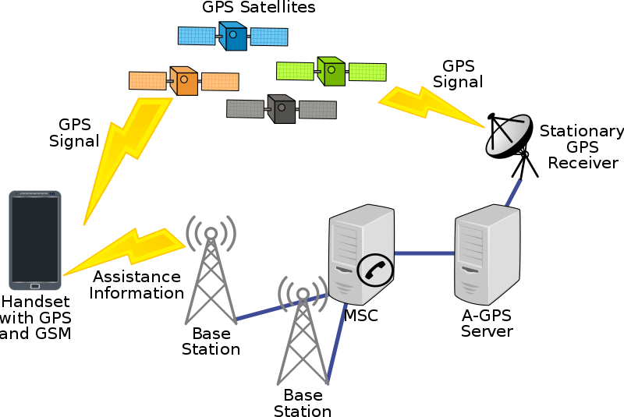
Assisted GPS
How is cell phone GPS so quick?
Download almanac from the internet (only 1.8 kB)
Bootstrap location information
Cell towers can give coarse position
Enables device to know which satellites are overhead

Slide 83
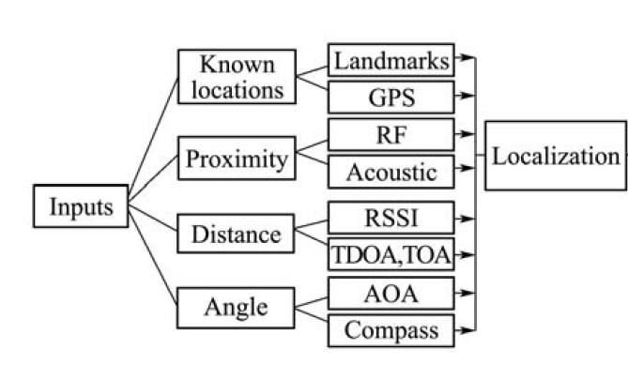
Overview of localization systems and modalities

Slide 84
What are anchor (beaconing) nodes?
Necessary to localize a network in a global coordinate system, also they can be used for finding relative coordinates
At a minimum
Three (non-collinear) beacons required to define a global coordinate system in two dimensions
Four non-coplanar beacons for 3-D coordinates
Beacon Placement
Significant impact on localization
Improves accuracy if placed in a convex hull around the network, additional beacon at the center

Slide 85
How to determine distances?
Making trilateration work requires distance measurements
There are numerous techniques for distance measurement
RSSI (Received Signal Strength Indicator)
Time of Flight/ Time of Arrival
Time Distance of Arrival

Slide 86
Received Signal Strength Indicators (RSSI)
RSSI - received signal-strength indication
In theory, RSSI varies with 1/d^{α}
One common assumption, nodes that are closer have stronger RSSI than those further
In practice, RSSI ranging measurements contain noise on the order of several meters, highly non-uniform
Radio propagation differs over different surface (water, grass, asphalt etc.)
Obstacles such as wall, furniture etc.

Slide 87
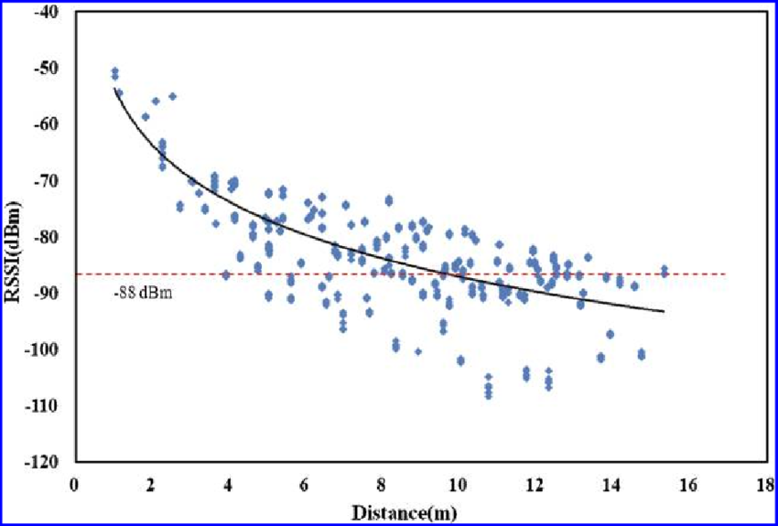
Problem with RSSI-based distance – not accurate
Pathloss is NOT only due to distance
RSSI is way worse at this than you hope it would be
Citation: literally everyone has made this figure at some point

Slide 88
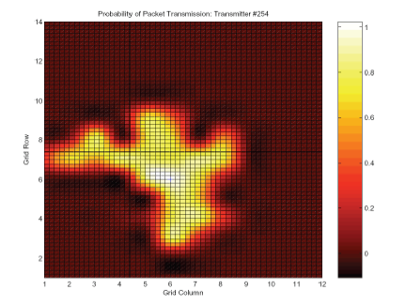
Received Signal Strength Indicators (RSSI)
RSSI utility can be improved with more careful physical analysis of radio propagation or better calibration of sensor radios

Slide 89
Other Ranging Methods

Slide 90
Time of flight (also known as time of arrival, ToA)
Determine distance by knowing:
Exact position of infrastructure
Transmit time
Receive time
Signal velocity (i.e. speed of light)
Infrastructure transmits and device listens
Can happen all the time, but devices only listen when they want a position
Requires time synchronization between infrastructure and device
Synchronization must be good: 1 μs = 300 meters

Slide 91
Time of flight (also known as time of arrival, ToA)
Important Considerations:
Speed of signal propagation
Distance to be measured
Clock accuracy
Example:
Speed of light (c) ~ 3x10⁸ m/s
Distance travel in 1ms = 300m
Clock accuracy needed for meter accuracy (1/c) ~ 3ns
Speed of sound (v) ~ 330 m/s
Distance travel in 1ms = 0.33m
Clock accuracy needed for meter accuracy = 1/v ~ 3ms

Slide 92
Time difference of arrival (TDoA)
Device transmits and infrastructure receives transmission
Multiple infrastructure nodes receive at different times based on distance
Determine distance by knowing
Exact position of infrastructure
Time of arrival at two different locations
Signal velocity (i.e. speed of light)
Doesn’t require synchronization with infrastructure!
Still requires synchronization between infrastructure nodes
Does require device to transmit loud enough for infrastructure to hear it…

Slide 93
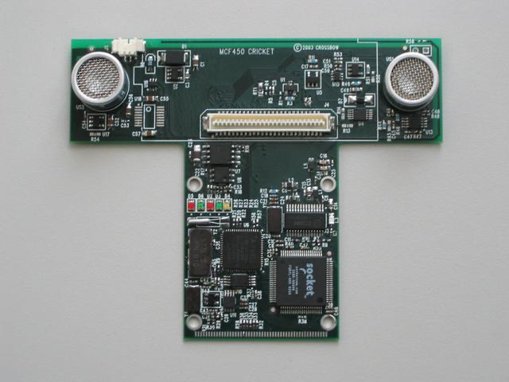
Time difference of arrival with different mediums
Exploit differences in speed, say RF and audio
Example: Cricket System [1]
In addition to a radio, each node also has a speaker and microphone
How does Cricket works?
Transmitter sends a radio message, waits some time (optionally) t_delay, sends audio “chirp” sound
Listener hears the radio signal, record time t_radio
Listener hears the audio signal, record time t_sound
[1] http://cricket.csail.mit.edu/

Slide 94
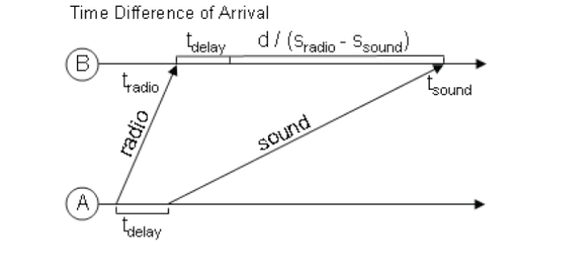
Time difference of arrival with different mediums
Time diff between signal arrival = d/S_{Sound} – d/S_{Radio} + t_{delay}
Works well in LOS environment
Cricket (uses ultra sound) can obtain close to cm accuracy
Requires additional hardware and works better with calibration

Slide 95

Cricket System: Demonstration

Slide 96
How many anchors are needed?
3 anchors gets a 2D location
4 anchors gets a 3D location

Slide 97
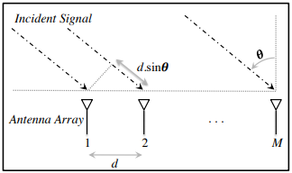
Angle of arrival (AoA)
Trilateration doesn’t only require distances, angles work
Antenna arrays can be used to determine the angle of an incoming signal
Allows the use of normal RF communication (WiFi or BLE)
BLE 5.1 includes AoA localization

Slide 98
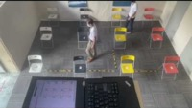
BLE 5 (AOA Positioning Demo)

Slide 99
Mapping existing infrastructure
Can we repurpose existing infrastructure for localization?
For example: WiFi access points
Benefit: localization works with unmodified hardware
Mapping instead of trilateration
Make a map of infrastructure and use that to locate device
Coarse example: existence of WiFi network SSIDs
Fine-grained example: signal strength to each Access Point
Known as fingerprinting

Slide 100
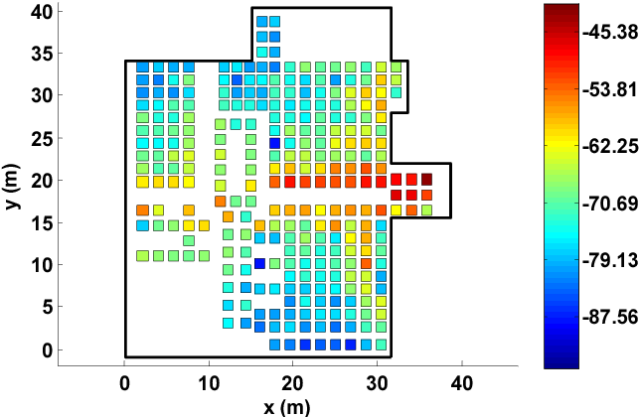
Fingerprinting overview
At setup time, for many locations throughout building
Measure signal strength to Access Point
Record measurement in a database with location
At run time, for the device that wants a location
Measure signal strength to Access Point
Look up measurement in database to get location

Slide 101
Fingerprinting improvements
Measurements can use several Access Points simultaneously
Improves accuracy quite a bit
Doesn’t have to be WiFi based at all
Cellular networks can do fingerprinting
Deploy your own BLE beacons throughout environment
Apply techniques for minimizing error in signal strength
Measurement won’t match record exactly
But minimizing error should approach the same location

Slide 102
Fingerprinting challenges
Effort to create database in the first place
Manually take measurements at every location
Environment is not stable
Signal strength changes as chairs, doors, and people move
Need ability to periodically re-measure
Update database with most recent recording while in use
Measurements vary between devices
Differ based on antennas, cases, how you hold it, etc.

Slide 103
Fingerprinting accuracy
State-of-the-art: median accuracy of 0.5-1.5 meters
Not bad depending on the application!
Likely places you in the right room, or at least nearby
Long tail can be large, but more access points helps this
Barrier problem capability depends on walls
Some materials attenuate signal strength more than others

Slide 104
Similarity of WiFi Fingerprints
Hong, Hande, et.al. "Socialprobe: Understanding social interaction through passive wifi monitoring." Mobiquitous 2016.

Slide 105
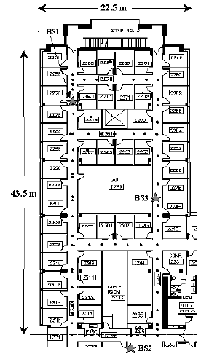
Localization using (WiFi) Fingerprinting
RADAR [2] is one of the earliest & most highly cited localization using WiFi based fingerprinting (>12,000 citations on scholar.google.com)
Testbed:
1 floor, 980 sq. meters, 50 rooms
3 base stations, 1 mobile host

Slide 106
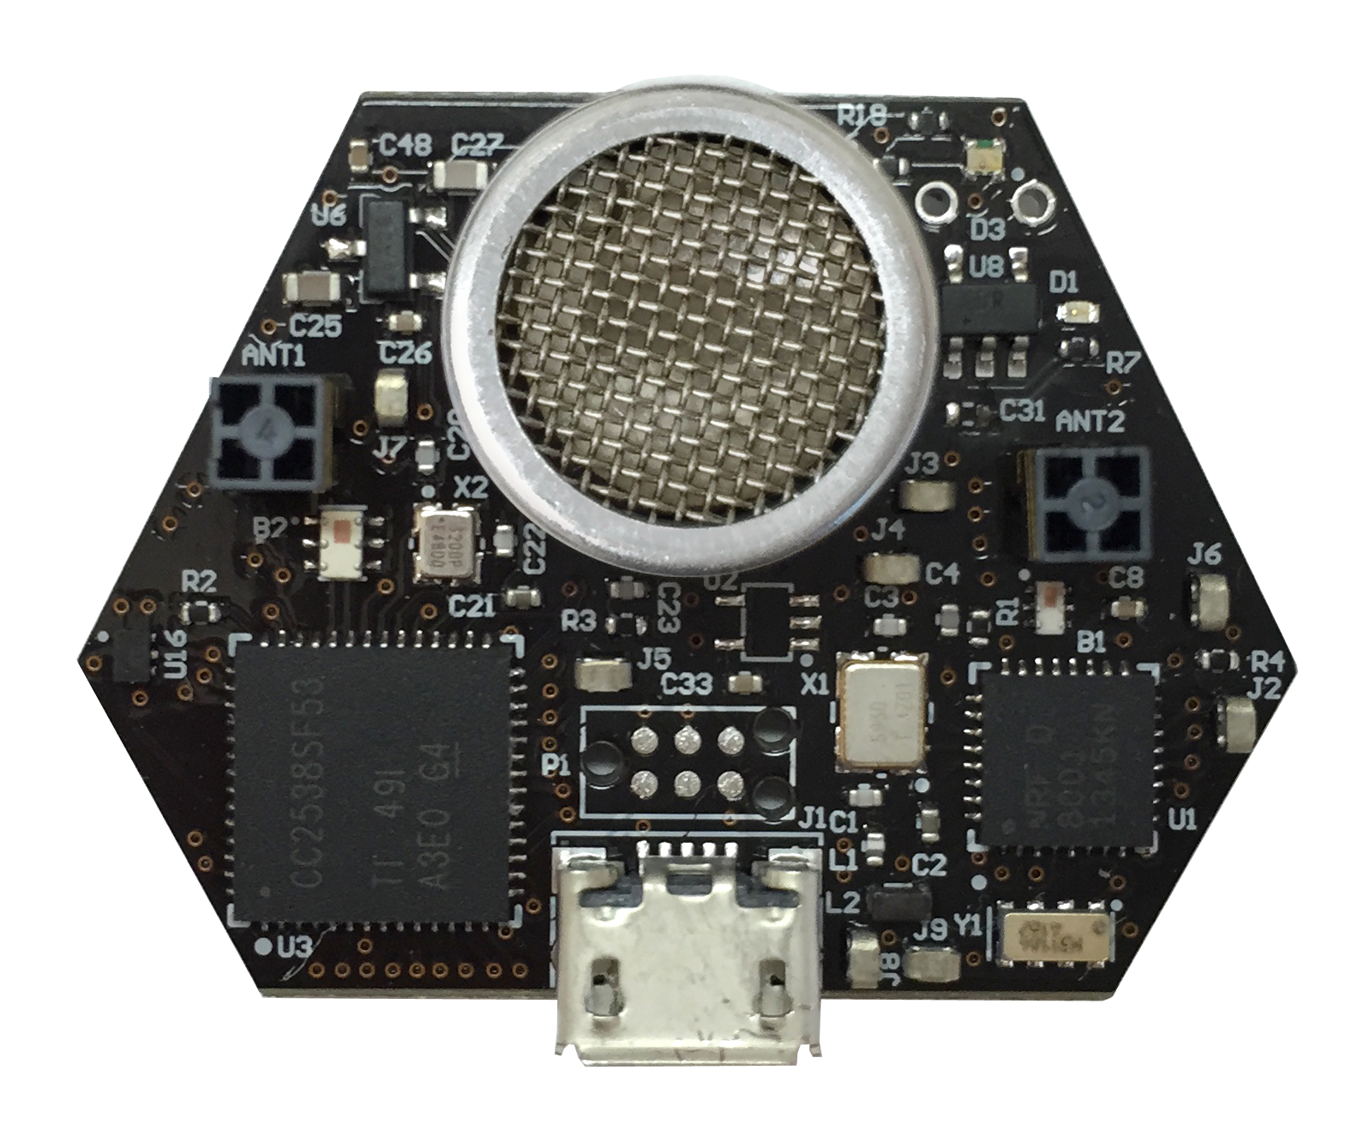
Ultrasound
Advantages
Solves the barrier problem
Human spaces already designed to contain sound
Easier to get high-accuracy results
Sound is ~1,000,000x slower than light
Less synchronization is needed to get same accuracy
Disadvantages
More energy to transmit
Slower update rate (still sub-second)
Limited range
Pets can hear it…

Slide 107
Inertial navigation
If you know acceleration, you can get position, just integrate!
With quite a bit of error
Accurate over short distances with filtering approaches
Can be used to augment other systems
Get a fix every few seconds from localization system
Use inertial navigation to interpolate between measurements
IMUs (Inertial Measurement Units) available in all smartphones
Accelerometer, Gyroscope, Magnetometer

Slide 108
Roadmap of the lecture today
General course information and updates
Let us review what we had covered the last lecture
MAC: Controlled Access
Medium access control for internet of things
Localisation
Notes:
Here is the roadmap of the major topics that I am going to cover during the presentation. We have already covered the exponential growth of the internet of things; next, I will talk about the critical energy challenge that can severely hinder this massive growth and preventing us from realising this immense economic value enabled by the IoT.

Slide 109
Next Week
NO Tutorial, NO Lecture
Doubts and QA: Please email TA’s – Kanav and Ayanga
Office hours: Still there. Please send me email for QA.
Video lectures: Will upload lecture to cover some topics due to missed lectures due to public holiday
Notes:
++ We may all have heard of the term Internet of Things. So how are these wireless embedded systems related to the Internet of Things: Today, IoT includes a broad class of devices, including powerful platforms such as smartphones. However, it also includes more resource-constrained devices and what we call Wireless Embedded Systems, and in fact, I consider it to be one of the essential parts of the IoT ecosystem.
++ These are platforms equipped with a radio transceiver, sensor, microcontroller, and some form of energy storage. These platforms also often form a network, and sensor network as it is called has been an active area of research for the past two decades.
++ The research community has also developed wireless embedded platforms which we may know about, and these include: CMUCAM, which is an image sensor platform developed at Carnegie Mellon University, or Permamote is long life sensor platform from the lab I am associated with at UC Berkeley or Lorea which is a long-range backscatter platform that I had developed as part of my doctoral dissertation at Uppsala University. All of these are an example of Wireless Embedded Systems.

Slide 110
Wireless Networking
Ambuj Varshney
ambujv@nus.edu.sg
Notes:
++ Thank you for inviting me to give this talk
++ In this talk, I will present a pathway that can enable us to make wireless embedded systems ubiquitous. I will describe my previous research efforts that tackle the critical challenges that limit the growth of wireless embedded systems. These are related to the growing energy asymmetry that exists between sensing, computation and communication blocks on these platforms.
++ Finally, I will conclude my talk by covering the research agenda that I would like to work on as a faculty member.

